Slide 1

A Web Performance Dashboard: Up and Running in 90 minutes
flickr photo courtesy of purplemattfish

Slide 2

About Us
Cliff Crocker
Aaron Kulick
VP, Product Management
SOASTA, Inc.
Performance monitoring, evangelism, analytics and pho connoisseur
@cliffcrocker
Chief Performance Engineer
@WalmartLabs
Founder of SFWebPerf.org meetup, WebPerfDays.org and lover of squirrels
@GoFastWeb

Slide 3
Images Provoke a Response
Notes:
Cliff:
People react to visual stimuli
We are just wired this way
Aaron and I both are extremely passionate about this – get your data in front of people

Slide 4
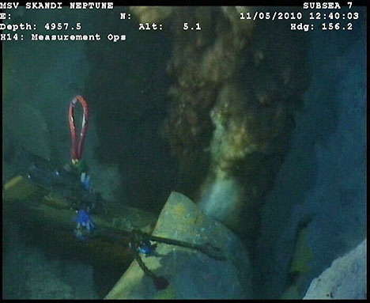
Foster a Sense of URGENCY!
Notes:
Cliff:
Effective dashboards can immediately convey that there is a problem or that the fix is not working!
Oil spill in the Gulf.
Message:
Something is definitely wrong here and the clock is ticking.

Slide 5
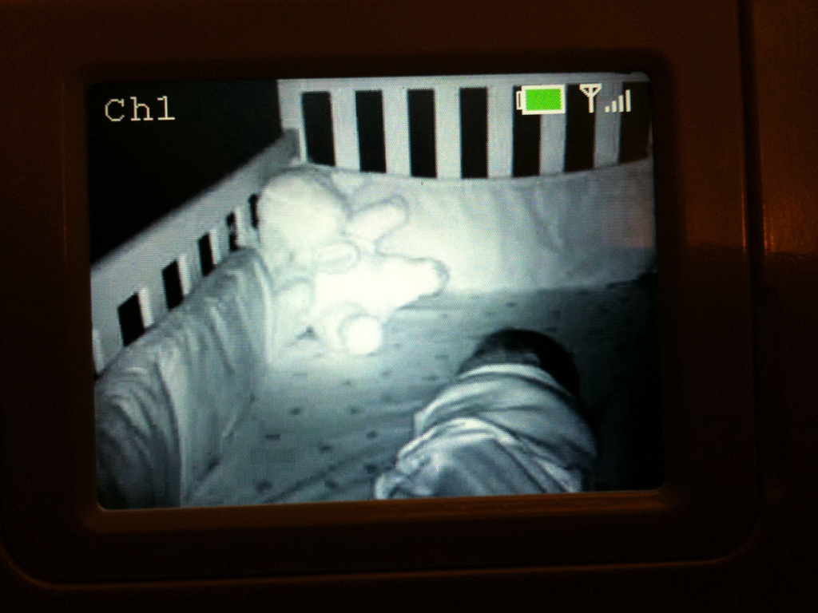
http://www.flickr.com/photos/barge/5013630976/lightbox/
Provide Reassurance - All is OK
Notes:
Cliff:
Conversely a good dashboard can convey a feeling that all is well with the world.
Creepy baby monitors are widely adopted by paranoid parents.
Message:
All is well with the world. You can relax.

Slide 6

Dashboards Should NOT Be Complicated
www.flickr.com
Notes:
Cliff:
As engineers, we are notorious for adding switches, complex configurations, and basically making dashboards unusable by anyone who can’t pilot a commercial airliner.
Keep it simple. Focus on what you want. Start with nothing, then add what you need as you need it.

Slide 7
A Simple 3 Step Approach to Building a Dashboard
Notes:
Cliff -> Aaron:
Setting the stage for today’s talk
‘Hack Day’ type solutions designed to provide you with a sandbox for experimenting with various web perf tools and data experimentation.

Slide 8
Step 1
identifying input & getting data

Slide 9

Notes:
A few months back, Aaron and I discussed a holistic approach to performance monitoring. Staying with this same approach, we will look at 3 or the 4 data sets mentioned in that presentation – eliminating first mile monitoring for this discussion.
RUM – Real user measurement
Synthetic – Puppeteered browser
Analytics – User behavior & demographics, site statistics

Slide 10
How Most RUM Solutions Work
Source external JS
Instrument page with start/end timers and/or leverage navigation timing API
Beacon containing timing data is fired at onload and sent to a beacon server

Slide 11
Getting Performance Data From Real Users
Episodes
  Some smart guy wrote this who knows something about web performance (Steve Souders)
boomerang.js
  Another smart guy wrote this (Phillip Tellis)
  Extensible (custom API for passing data to beacon)
ShowSlow
  Yet another smart guy (Sergey Chernyshev – “mmm beacons”)
  Crowdsourcing
Roll your own
  You can be the smart person to write this

Slide 12
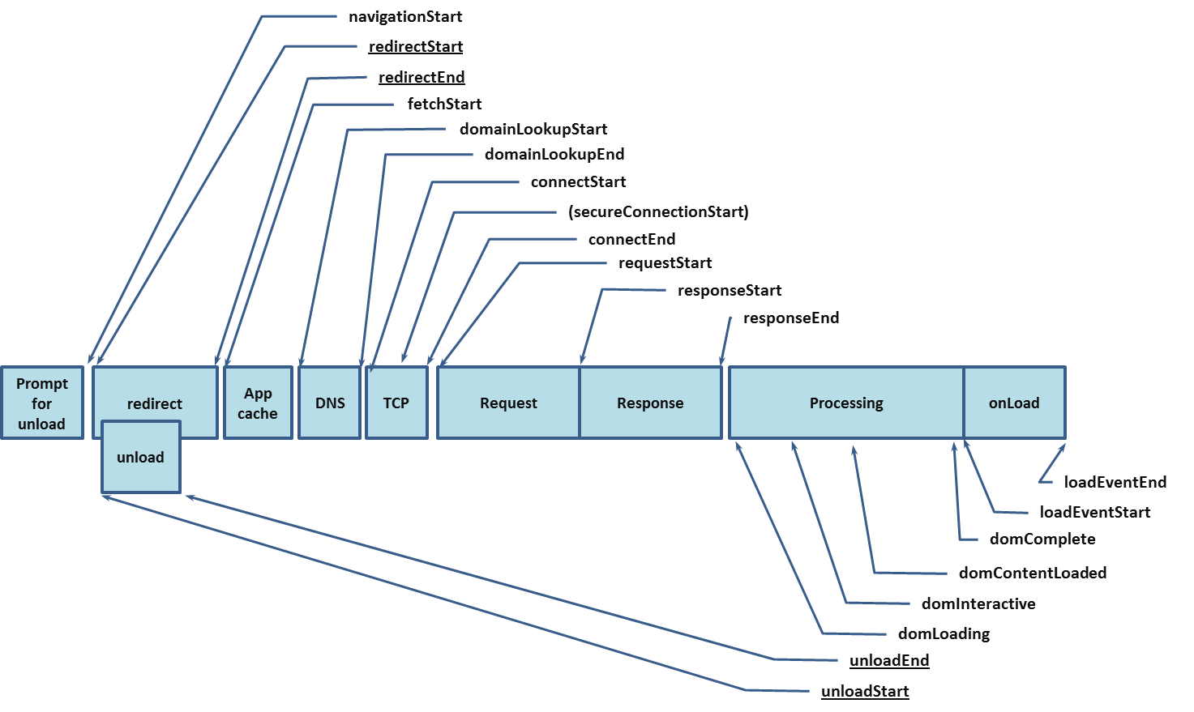
W3C Navigation Timing
http://www.w3.org/TR/navigation-timing/

Slide 13
Today We are Using boomerang.js
Steps:
  Git:
    https://github.com/lognormal/boomerang/
  Include:
  Initialize:
<script src="/javascript/boomerang.js" type="text/javascript"></script>
BOOMR.init({
beacon_url: "http://beacons.yoursite.com/path/to/beacon.gif",
site_domain: "yoursite.com”
});

Slide 14
Today We are Using boomerang.js
(continued)
Steps:
  Extend:
BOOMR.addVar({
var1: “bing",
var2: “bang",
var3: “boom”
});
BOOMR.plugins.RT.startTimer(“t_timer”);
//some foo
BOOMR.plugins.RT.endTimer(“t_timer”);

Slide 15
Ghetto-Fabulous
<script src="/javascript/boomerang.js" type="text/javascript"></script>
For the high-performance, non-blocking, self-updating version, see:
http://www.stevesouders.com/blog/2012/05/22/self-updating-scripts/
http://www.lognormal.com/blog/2012/06/05/updating-cached-boomerang/

Slide 16
Synthetic Data
Consistency
Object level detail
High signal to noise ratio
Instrumented real browsers

Slide 17
Getting Synthetic Data
WebPagetest.org
REDbot.org
cURL
ShowSlow
PageSpeed Insights
GTmetrix.com
Vendor supported solutions

Slide 18
WebPagetest
Steps:
  Download:
    https://sites.google.com/a/webpagetest.org/docs/private-instances/releases
  Configure:
    https://sites.google.com/a/webpagetest.org/docs/private-instances#TOC-Configuring
  Automate:
    Script foo
    Bribe Patrick Meenan for an API key

Slide 19
Example: Walmart Competitive Index
Ingredients:
  URL file
  Cron job
  MySQL
  Flot (javascript)

Slide 20
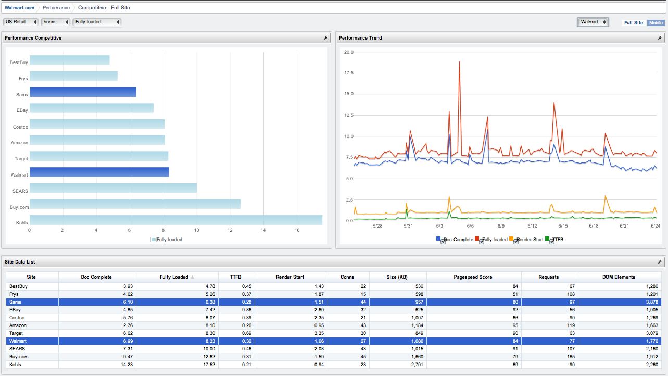
Example: Walmart Competitive Index
(continued)

Slide 21
Analytics
Conversion
  Add to cart
  Click
Engagement
  Bounce, exit, and entry
  Time on page/site
Demographics
  Geography
  Browser, device, OS, screen size
Flow
  Utilization
SEO, SEM, and campaign effectiveness
  A/B, MAB

Slide 22
Analytics
Piwik.org
Google Analytics
Log analysis (BFD)
Vendor supported solution

Slide 23
Piwik
Steps:
  Download:
    http://www.piwik.org
  Install:
    MySQL
    PHP
  Instrument:

Slide 24
Piwik
(continued)
<!--Piwik tracking -->
<script type="text/javascript">
var pkBaseURL = (("https:" == document.location.protocol) ? "https://localhost/test/piwik/" : "http://localhost/test/piwik/");
document.write(unescape("%3Cscript src='" + pkBaseURL + "piwik.js' type='text/javascript'%3E%3C/script%3E"));
BOOMR.subscribe ('before_beacon', function (o) {
try {
var piwikTracker = Piwik.getTracker(pkBaseURL + "piwik.php", 2);
piwikTracker.setCustomVariable (1, "Page Load - sec", Math.ceil((o.t_done/1000)), "page");
piwikTracker.setCustomVariable (2, "Page Processing - sec.", Math.ceil((o.t_page/1000)), "page");
piwikTracker.setCustomVariable (3, "Response - sec", Math.ceil((o.t_resp/1000)), "page");
piwikTracker.setCustomVariable (4, "Latency - msec", o.lat, "visit");
piwikTracker.setCustomVariable (5, "Bandwidth - kbps", Math.ceil((o.bw/1024)), "visit");
piwikTracker.trackPageView();
piwikTracker.enableLinkTracking();
} catch( err ) {}
});
</script>
<!--stone tools-->
<noscript><p><img src="http://localhost/test/piwik/piwik.php?idsite=2" style="border:0" alt="" /></p></noscript>
<!--End Piwik Tracking Code -->
*boomerang integration
**not like this!!

Slide 25
Step 2
collecting, processing & storing data

Slide 26
How It Works boomerang.js -> StatsD -> Graphite
JavaScript triggers image request
Beacon server responds with 204 (no cache)
StatsD aggregates metrics
Graphite stores and provides UI

Slide 27
How It Works
Script foo -> WebPagetest API -> MySQL
wpt_batch.py – submit a batch job for processing
WebPagetest API – run tests
parse_xml.pl – parse XML response
MySQL – store median results
Piwik – CompWPT plugin displays results

Slide 28
Step 3
pulling it into a dashboard
“Make Them Happy Trees”

Slide 29

Introducing our Sponsor
Sally Squirrel’s Dance Emporium

Slide 30
Demo
Demo Site
WebPagetest
REDbot
Graphite
WebPerf90 Dashboard - Piwik

Slide 31
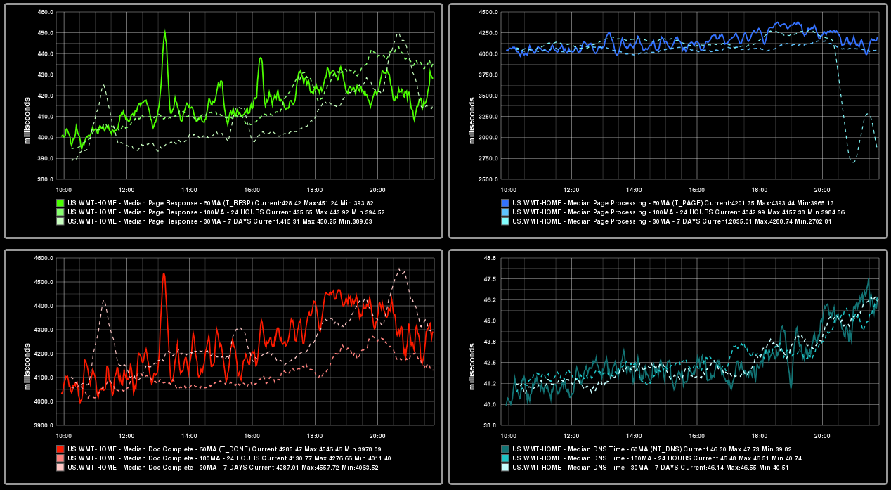
Operational RUM

Slide 32
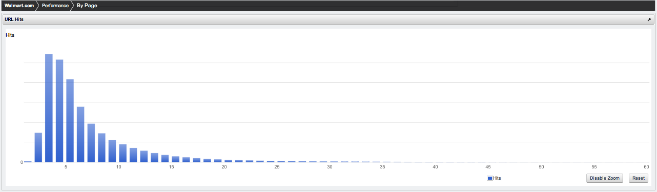
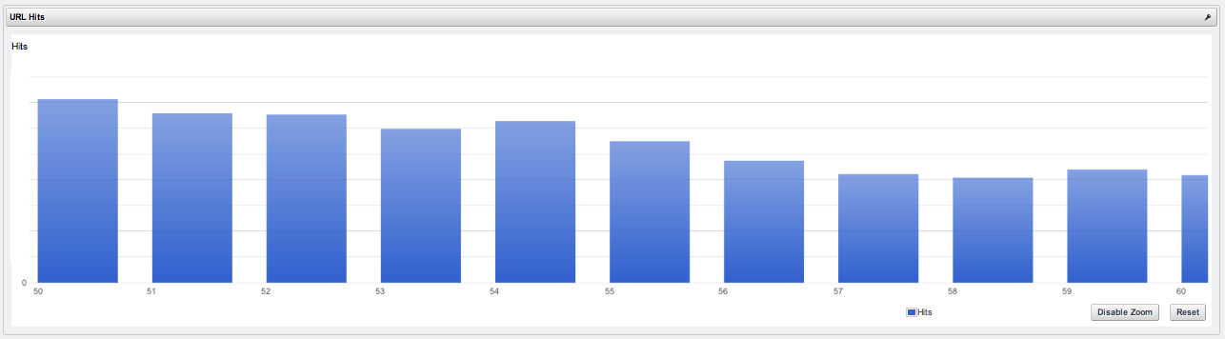
Where Should You Focus?
Buying stuff
Much less likely to buy stuff
Probably on an airplane
yes, there are people here….

Slide 33
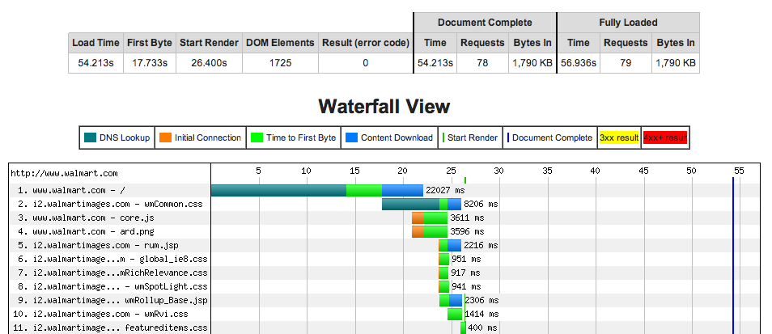
WebPagetest AIR
@patmeenan
“For the next ~3 hours, WebPagetest has a Virgin in-flight wifi location available. Last location in the list. #webperf”
@cliffcrocker
“@patmeenan > Holy Slow! “
@patmeenan
“@cliffcrocker Yep - when it's even connecting. Talk about a first-world problem.”

Slide 34
How Do You Optimize for the Given Distribution?
Traditional WPO Techniques – 14+ Rules
Advanced Optimization/Acceleration – Automated WPO
Prayer

Slide 35
Set Achievable SLAs
Find Your Own Meaningful Metric
“Item Page – ‘page processing’ should be 18s or faster for 95% of users”

Slide 36
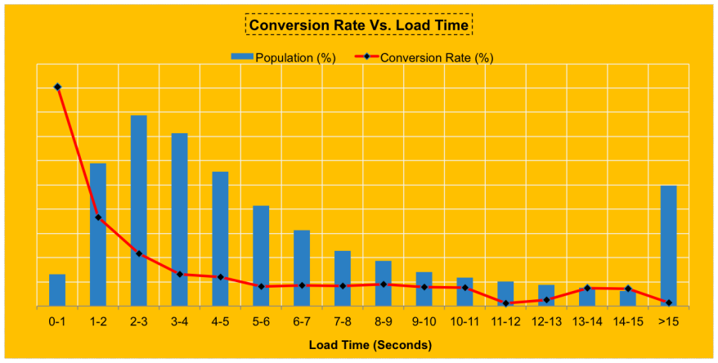
Validate With Analytics

Slide 37
Acknowledgements
Software | Special Thanks
boomerang.js | Phil & Buddy (logNormal)
WebPagetest | Pat Meenan
Node Beacon | Rick Crawford
ShowSlow | Sergey Chernyshev
wpt_batch | Qi Zhao
REDbot | Mark Nottingham
HAR Viewer | Jan Odvarko
Graphite
Piwik
PageSpeed Insights
http://dl.dropbox.com/u/49030329/WebPerformanceDashboard90.ova

Slide 38
VM INSTRUCTIONS
Username: webperfdash
Password: webperfdash
To start the Graphite, node beacon, StatsD, and REDbot log into the VM and execute the following command as the ‘webperfdash’ user from the home directory:
$ supervisord
The VM should just work (but you may need to disable USB 2.0 controller on import if you do not have the Oracle VM VirtualBox Extensions, see website) in VirtualBox
which is available for free for Windows, OS X, or Linux.
If you get a USB 2.0 incompatibility error on start then you do not have the the above extension installed and should disable USB when importing the appliance or via the settings or install the extensions directly.
The VM has two NICs configured, the first is configured for NAT and the ports are already forwarded. The second uses the HOST NETWORKING scheme (http://www.virtualbox.org/manual/ch06.html#network_hostonly) which creates a private network shared exclusively by the VM and the host (or any other addition hosts such as WebPagetest workers).

Slide 39
Ports
Service | Port Number
SSH | 42222
Demo Site | 40000
Graphite | 49999
HAR Viewer | 44444
REDbot | 45555
WebPagetest | 48888
ShowSlow | 47777
boomerang.js Beacon Server | 43000
Piwik | 48080

Slide 40
Aaron & Cliff
Office Hours
Tuesday 3:50p -4:30p
Exhibit Hall – Office Hours ‘C’

Slide 41

WebPerfDays.org

Slide 42

Come by our booth!

Slide 43
We’re Hiring!

